Slide 1
CARDOMAX
Manufactured by: M/s. Kalaga Herbal research Labs Pvt Ltd., and
Marketed by: M/s. Kalaga Integrated Health Care Pvt Ltd.
Endothelial Dysfunction and Inflammation are the basic root causes of Cardio Vascular Diseases (CVD) and CARDOMAX can improve Vascular Function and General Health.
Non-Invasive Medical Management of CVD
1 or 2 CAP –Bi-Daily for a period of 90 days or as advised by Physician
FORMULATOR OF CARDOMAX - DR. K.V.G.S. MURTY, MBBS

Slide 2
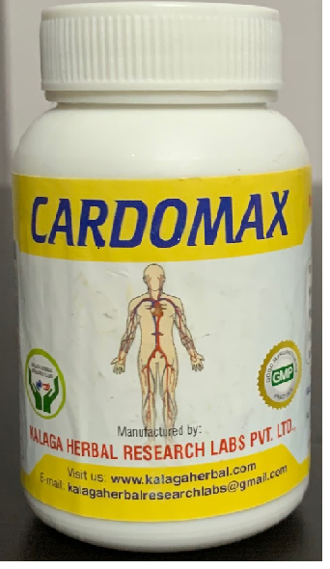
Manufactured by: M/s. Kalaga Herbal research Labs Pvt Ltd., and
Marketed by: M/s. Kalaga Integrated Health Care Pvt Ltd.
Cardomax – Capsules Benefits:
Addresses Endothelial Dysfunction, by correction of Nitric Oxide Bio- availability.
Acts as Blood thinner.
Improves blood circulation.
Improves LVEF or Heart Pumping Capacity function.
Strengthens Heart Mussels.
Supports Anti-Inflammatory, Anti-Oxidant and Anti-tumour activity.
Improves Insulin sensitivity
Manufactured by: M/s. Kalaga Herbal Research Labs Pvt Ltd., 16-4-38, First Floor, Kalaga Mart, M. G. Road, Palakollu -534260, W. G. Dt., Andhra Pradesh.
technical@kalagaherbal.com, drkvgsmurty@kalagaherbal.com www.kalagaherbal.com
Marketed by: M/s. Kalaga Integrated Health Care Pvt Ltd., 2-2-1109/1, Flat No. 501, Brindavan Apartments, Bagh Amberpet, Hyderabad -50013, Telangana.
technical@kalagahealth.com, drkvgsmurty@kalagaheaalth.com www.kalagahealth.com
FORMULATOR OF CARDOMAX - DR. K.V.G.S. MURTY, MBBS

Slide 3
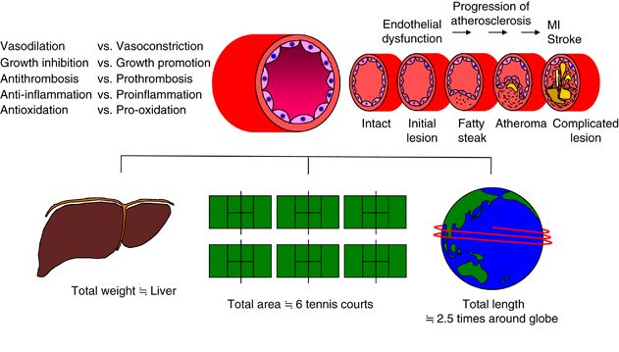
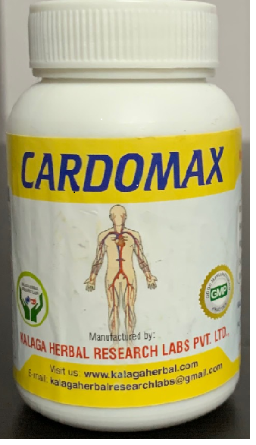
Manufactured by: M/s. Kalaga Herbal research Labs Pvt Ltd., and
Marketed by: M/s. Kalaga Integrated Health Care Pvt Ltd.
Endothelial Functions
In average life time heart pumps around 1,000,000 barrels of blood.
Human vascular tree length (Arteries, veins capillaries etc.) 100,000 miles.
Endothelium helps to keep vascular homeostasis and its function, is not only autocrine, but also paracrine and endocrine.
FORMULATOR OF CARDOMAX - DR. K.V.G.S. MURTY, MBBS

Slide 4
Manufactured by: M/s. Kalaga Herbal research Labs Pvt Ltd., and
Marketed by: M/s. Kalaga Integrated Health Care Pvt Ltd.
FORMULATOR OF CARDOMAX - DR. K.V.G.S. MURTY, MBBS

Slide 5
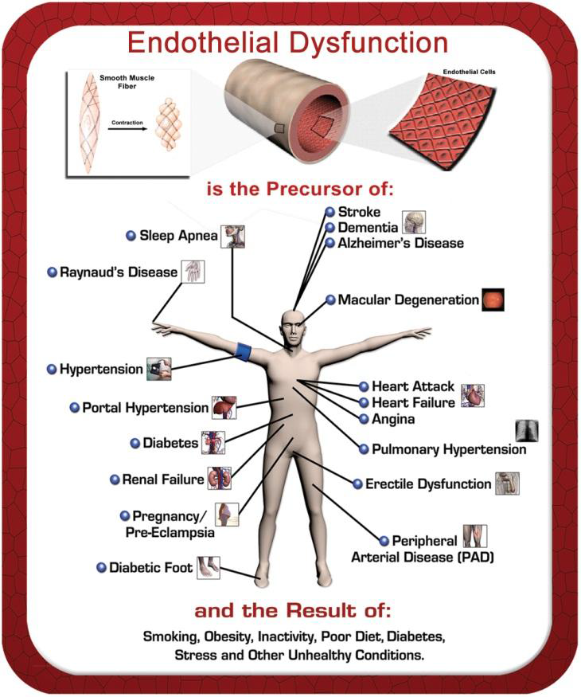
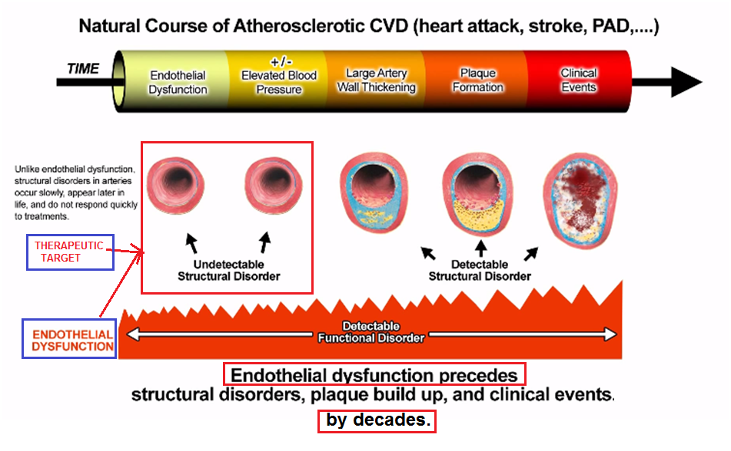
Manufactured by: M/s. Kalaga Herbal research Labs Pvt Ltd., and
Marketed by: M/s. Kalaga Integrated Health Care Pvt Ltd.
FORMULATOR OF CARDOMAX - DR. K.V.G.S. MURTY, MBBS

Slide 6
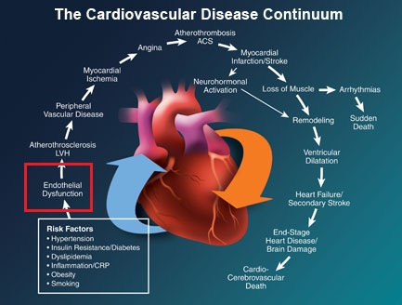
Manufactured by: M/s. Kalaga Herbal research Labs Pvt Ltd., and
Marketed by: M/s. Kalaga Integrated Health Care Pvt Ltd.
FORMULATOR OF CARDOMAX - DR. K.V.G.S. MURTY, MBBS

Slide 7
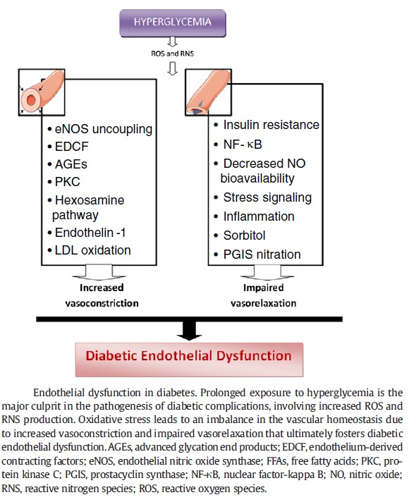
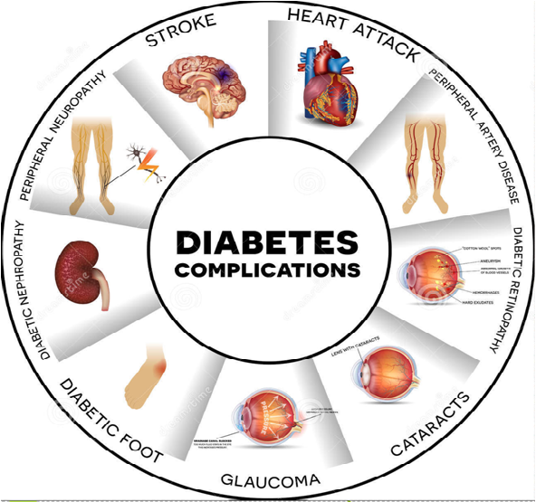
Manufactured by: M/s. Kalaga Herbal research Labs Pvt Ltd., and
Marketed by: M/s. Kalaga Integrated Health Care Pvt Ltd.
FORMULATOR OF CARDOMAX - DR. K.V.G.S. MURTY, MBBS

Slide 8
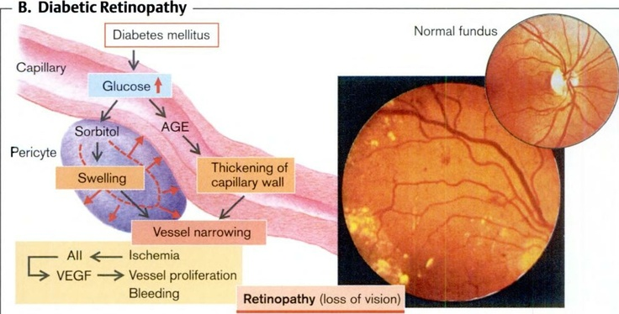
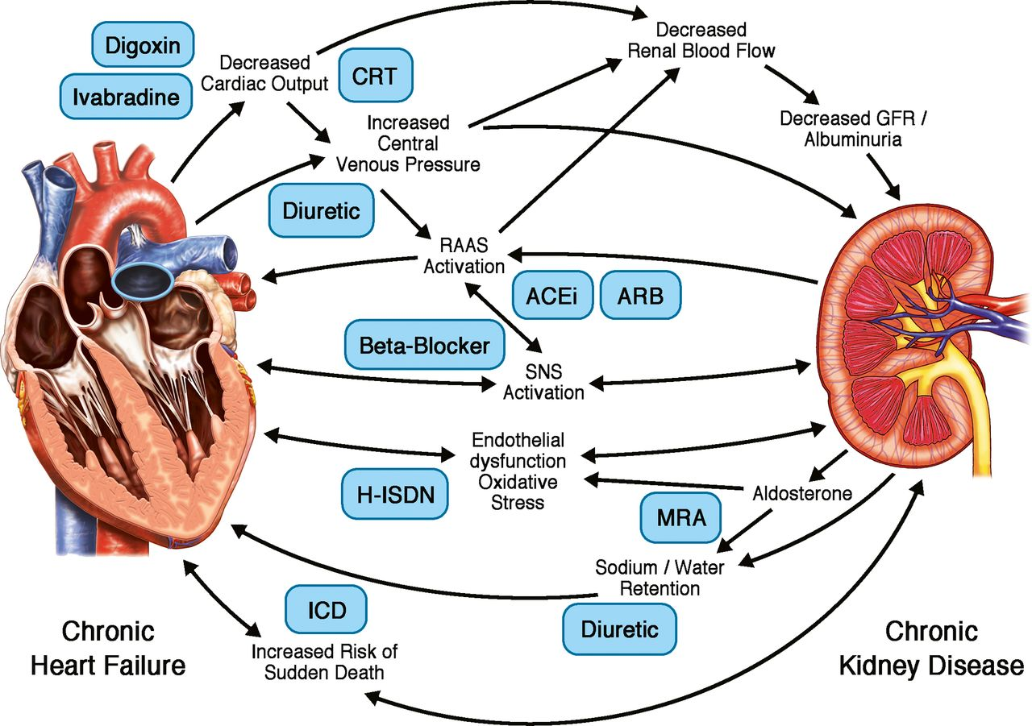
Manufactured by: M/s. Kalaga Herbal research Labs Pvt Ltd., and
Marketed by: M/s. Kalaga Integrated Health Care Pvt Ltd.
FORMULATOR OF CARDOMAX - DR. K.V.G.S. MURTY, MBBS

Slide 9
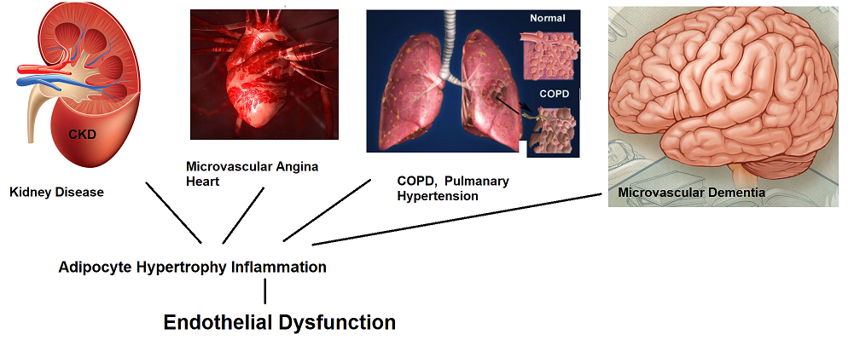
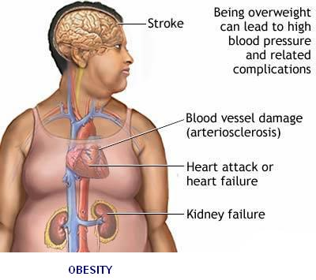
Manufactured by: M/s. Kalaga Herbal research Labs Pvt Ltd., and
Marketed by: M/s. Kalaga Integrated Health Care Pvt Ltd.
FORMULATOR OF CARDOMAX - DR. K.V.G.S. MURTY, MBBS

Slide 10
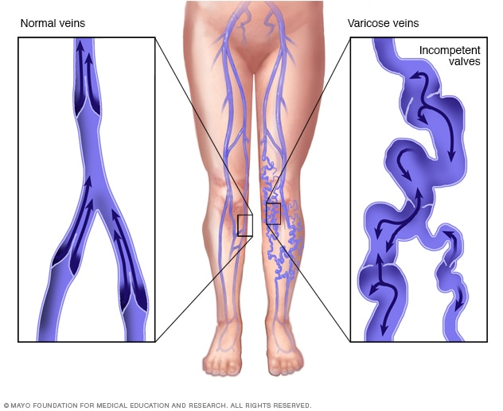
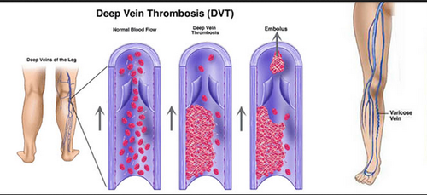
Manufactured by: M/s. Kalaga Herbal research Labs Pvt Ltd., and
Marketed by: M/s. Kalaga Integrated Health Care Pvt Ltd.
FORMULATOR OF CARDOMAX - DR. K.V.G.S. MURTY, MBBS

Slide 11
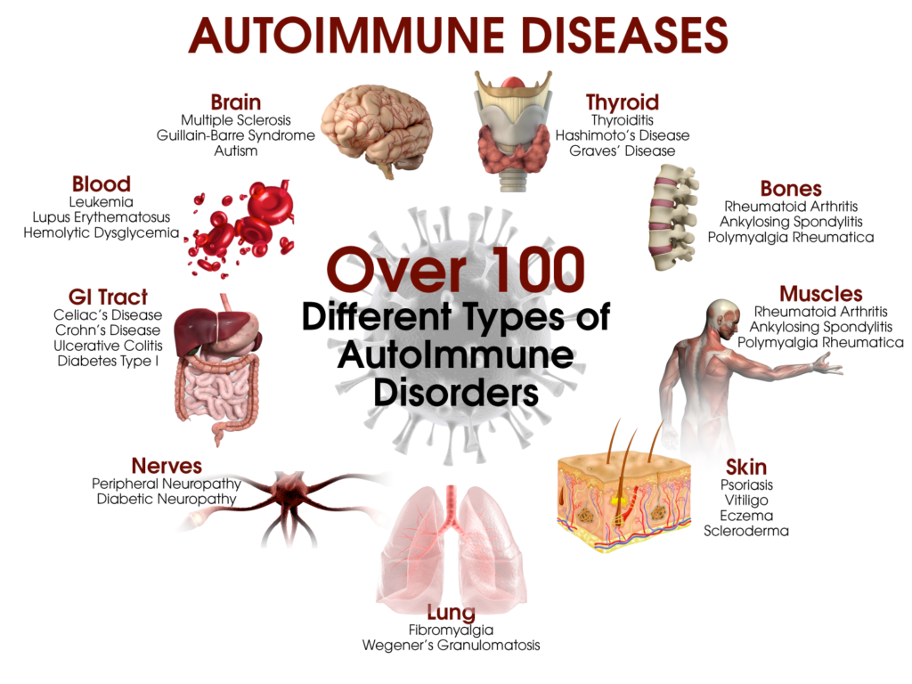
Manufactured by: M/s. Kalaga Herbal research Labs Pvt Ltd., and
Marketed by: M/s. Kalaga Integrated Health Care Pvt Ltd.
FORMULATOR OF CARDOMAX - DR. K.V.G.S. MURTY, MBBS

Slide 12
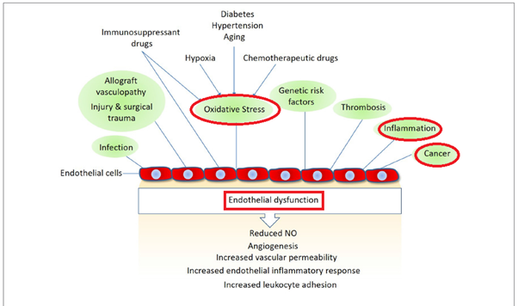
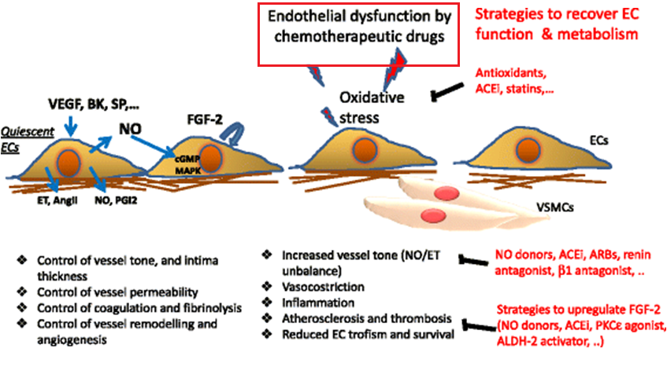
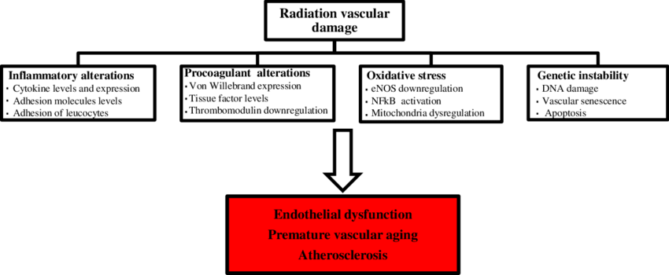
Manufactured by: M/s. Kalaga Herbal research Labs Pvt Ltd., and
Marketed by: M/s. Kalaga Integrated Health Care Pvt Ltd.
Cancer
FORMULATOR OF CARDOMAX - DR. K.V.G.S. MURTY, MBBS

Slide 13
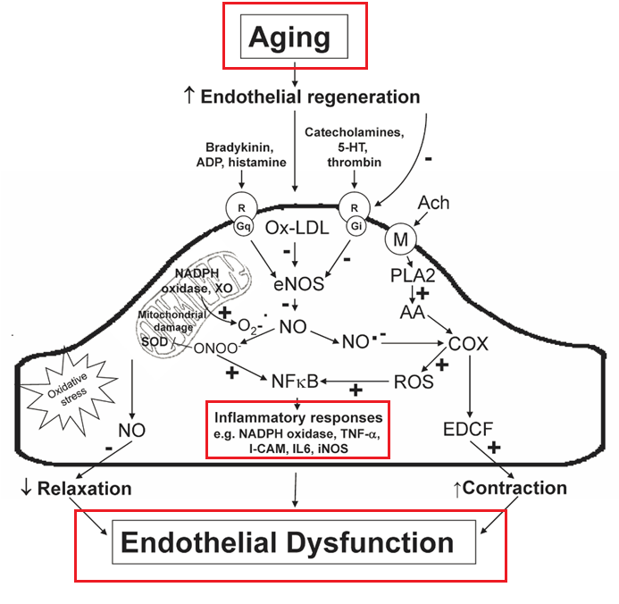
Manufactured by: M/s. Kalaga Herbal research Labs Pvt Ltd., and
Marketed by: M/s. Kalaga Integrated Health Care Pvt Ltd.
Endothelial Dysfunction and Ageing
NO *
Vasodilatation Growth inhibition, Anti-apoptotic, Anti-thrombotic, Anti-inflammatory, Anti-Oxidant
Vasoconstriction, Growth Stimulation,
Pro-apoptotic, Pro-thrombotic,
Pro-inflammatory,
Pro-Oxidant
ox LDL
Normal Endothelial function
FORMULATOR OF CARDOMAX - DR. K.V.G.S. MURTY, MBBS

Slide 14
Manufactured by: M/s. Kalaga Herbal research Labs Pvt Ltd., and
Marketed by: M/s. Kalaga Integrated Health Care Pvt Ltd.
Sl. No. | Sanskrit Name Or Local Name | Botanical Name | Part used | Classical Reference
1 | Arjuna | Terminalia arjuna | Stem | API – Vol II, P 17-18
2 | Gokhru | Tribulus terrestris L | Fruit | API – Vol I, P 39
3 | Pushkarmool | Inula racemosa | Root | API – Vol IV, P 102
4 | Jatamansi | Nardostachys jatamansi | Root | API – Vol I, P 86-88
5 | Burans | Rhododendron arboreum | Flower | Sushruta-Sushrut Samhita sutra stana page 390, 391,392,393. P. V Prof, with English translation& Dalhana’s commentary ,Vol I reprint, ChaukhambaVisva Bharati, Varanasi, 1998. Singh T B & Chunekar KC Dr , Glossarry of Vegetable Drugs in Brhattrayi Chaukhamba Sanskrit series , Varanasi, 447- 448, 1972
6 | Guggulu | Commiphora mukul | Gum Resin | API PART – I, VOL – I, 28 PAGE NOS. 73 - 74
7 | Lashuna | Allium sativam Linn. | Bulb | API PART – I, VOL – III, 50 PAGE NOS. 163 to 165
8 | Guduci | Tinospora cordifolia | Whole plant | API PART – I, VOL – I, 27 PAGE NOS. 70 -72
9 | Amlavetas | Hippophae salcifora | Fruit | The Ayurvedic Formulary of India – Part III – Page 420, Item – 11, Department of AYUSH, Govt. Of India, Central Council for Research in Ayurveda and Sidda, Unani, Youga, Homeopathy (CCRAS), New Delhi. 2011
FORMULATOR OF CARDOMAX - DR. K.V.G.S. MURTY, MBBS

Slide 15
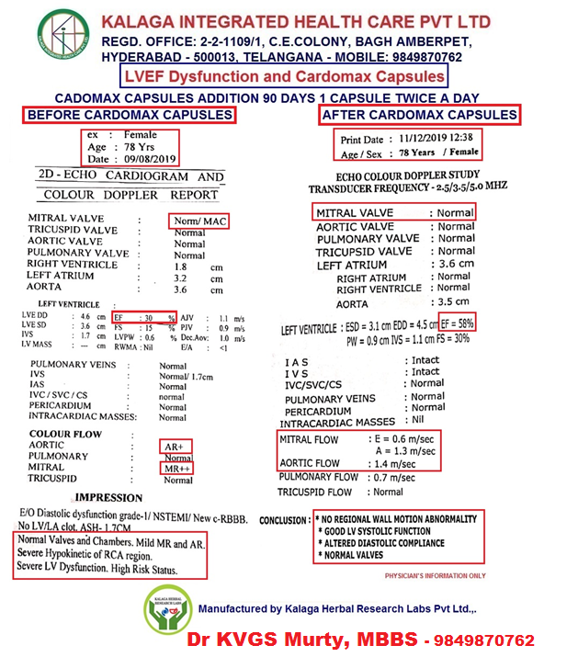
Manufactured by: M/s. Kalaga Herbal research Labs Pvt Ltd., and
Marketed by: M/s. Kalaga Integrated Health Care Pvt Ltd.
FORMULATOR OF CARDOMAX - DR. K.V.G.S. MURTY, MBBS

