Slide 1
HEPATOPROVE
Manufactured by: M/s. Kalaga Herbal research Labs Pvt Ltd., and
Marketed by: M/s. Kalaga Integrated Health Care Pvt Ltd.
Broad Spectrum Liver Protector and improves and supports its functions
1 or 2 CAP –Bi-Daily for a period of 90 days or as advised by Physician
FORMULATOR OF HEPATOPROVE - DR. K.V.G.S. MURTY, MBBS

Slide 2
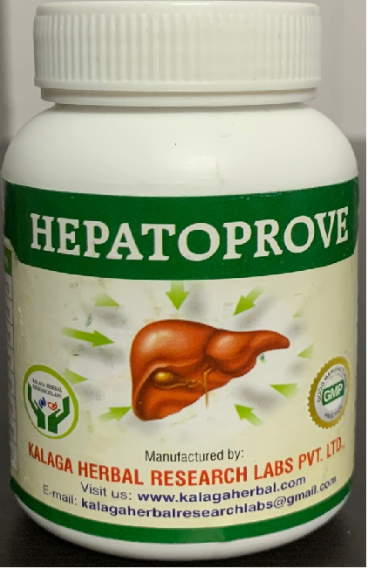
Manufactured by: M/s. Kalaga Herbal research Labs Pvt Ltd., and
Marketed by: M/s. Kalaga Integrated Health Care Pvt Ltd.
Hepatoprove – Capsules Benefits:
Improves Liver metabolic and general functions.
Supports in Regulation of Liver storage function (Buffer management).
Supports in Regulation of Excretory and Secretory functions of Liver (Bile Duct, etc.).
Corrects Liver issues like Fatty Liver with Lipid lowering, Anti – Oxidant, Anti - inflammatory, Anti – Viral and Anti – Tumour actions.
Supports detoxication of Liver (& body).
Supports liver cell regeneration.
Manufactured by: M/s. Kalaga Herbal Research Labs Pvt Ltd., 16-4-38, First Floor, Kalaga Mart, M. G. Road, Palakollu -534260, W. G. Dt., Andhra Pradesh.
technical@kalagaherbal.com, drkvgsmurty@kalagaherbal.com www.kalagaherbal.com
Marketed by: M/s. Kalaga Integrated Health Care Pvt Ltd., 2-2-1109/1, Flat No. 501, Brindavan Apartments, Bagh Amberpet, Hyderabad -50013, Telangana.
technical@kalagahealth.com, drkvgsmurty@kalagaheaalth.com www.kalagahealth.com
FORMULATOR OF HEPATOPROVE - DR. K.V.G.S. MURTY, MBBS

Slide 3
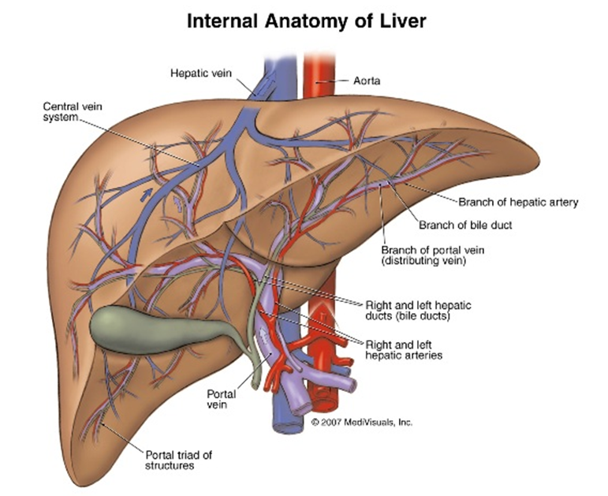
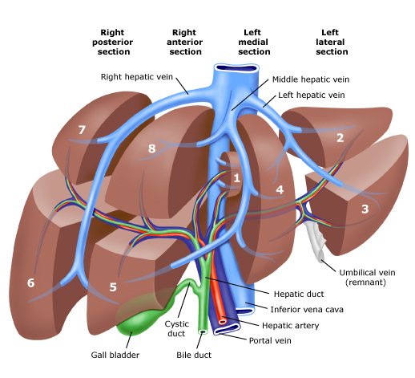
Manufactured by: M/s. Kalaga Herbal research Labs Pvt Ltd., and
Marketed by: M/s. Kalaga Integrated Health Care Pvt Ltd.
Liver is the Largest
Organ in the
Human Body
FORMULATOR OF HEPATOPROVE - DR. K.V.G.S. MURTY, MBBS

Slide 4
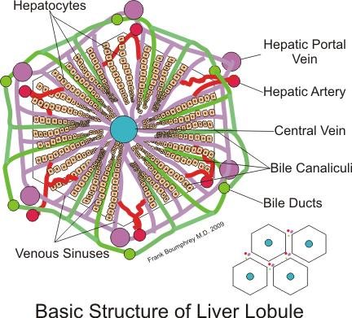
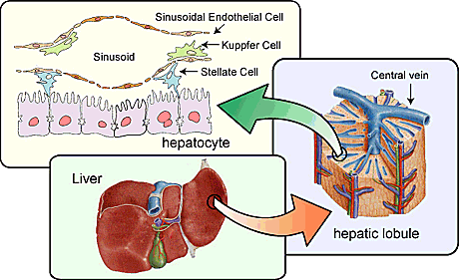
Manufactured by: M/s. Kalaga Herbal research Labs Pvt Ltd., and
Marketed by: M/s. Kalaga Integrated Health Care Pvt Ltd.
FORMULATOR OF HEPATOPROVE - DR. K.V.G.S. MURTY, MBBS

Slide 5
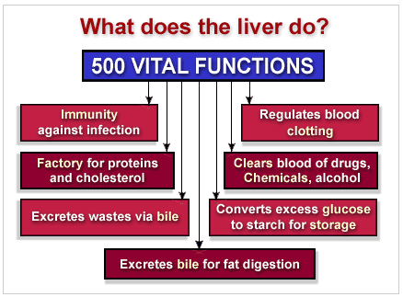
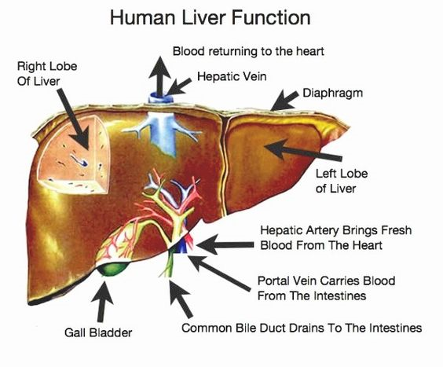
Manufactured by: M/s. Kalaga Herbal research Labs Pvt Ltd., and
Marketed by: M/s. Kalaga Integrated Health Care Pvt Ltd.
FORMULATOR OF HEPATOPROVE - DR. K.V.G.S. MURTY, MBBS

Slide 6
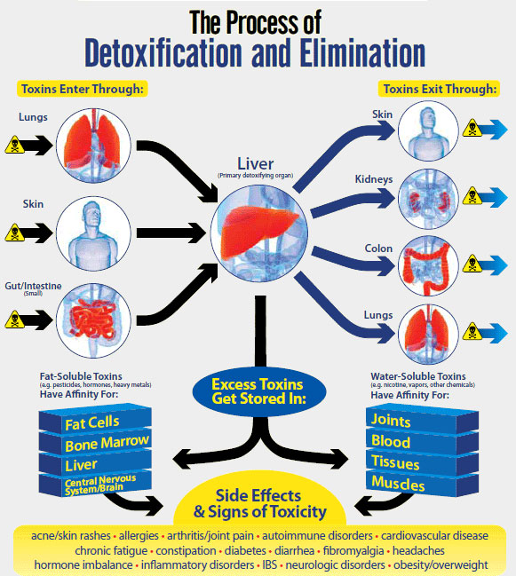
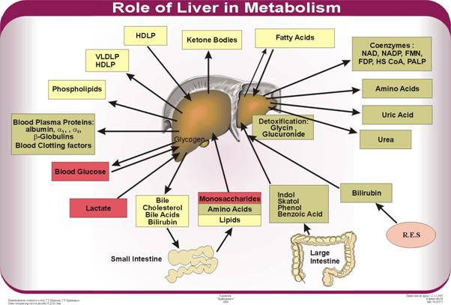
Manufactured by: M/s. Kalaga Herbal research Labs Pvt Ltd., and
Marketed by: M/s. Kalaga Integrated Health Care Pvt Ltd.
FORMULATOR OF HEPATOPROVE - DR. K.V.G.S. MURTY, MBBS

Slide 7
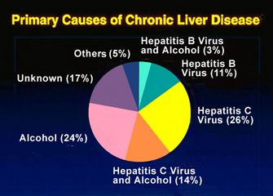
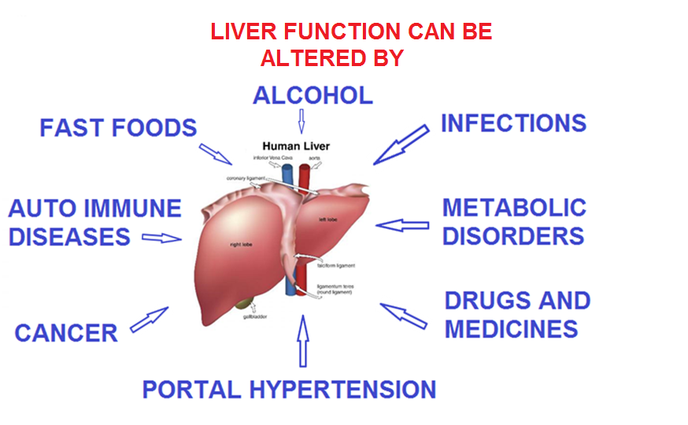
Manufactured by: M/s. Kalaga Herbal research Labs Pvt Ltd., and
Marketed by: M/s. Kalaga Integrated Health Care Pvt Ltd.
FORMULATOR OF HEPATOPROVE - DR. K.V.G.S. MURTY, MBBS

Slide 8
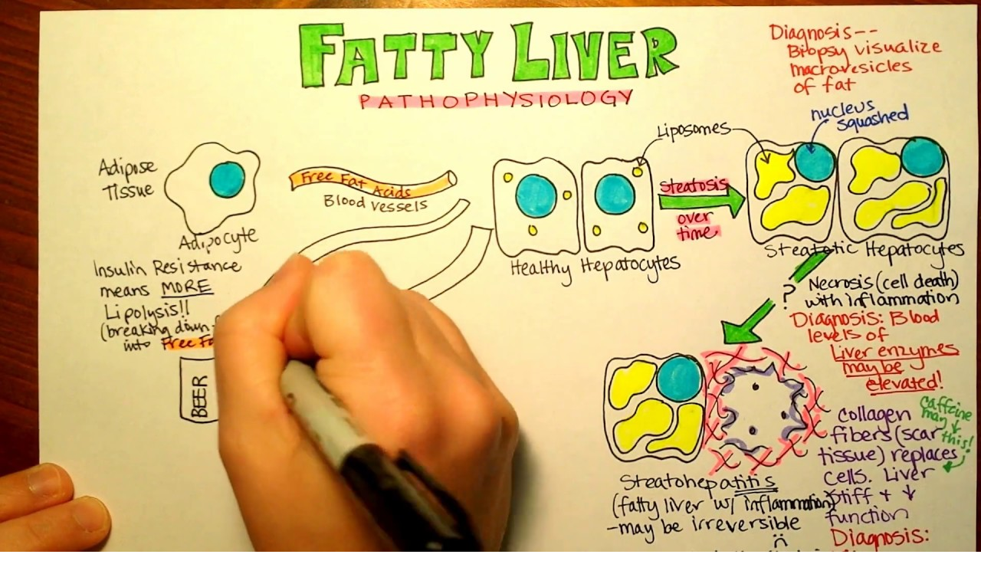
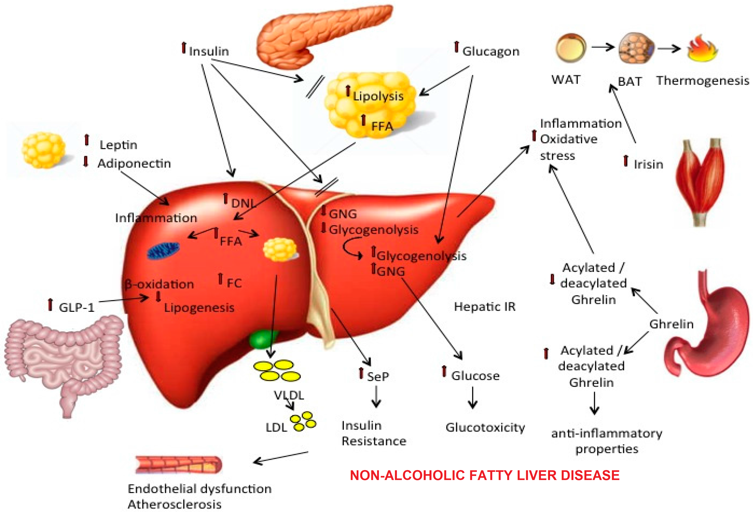
Manufactured by: M/s. Kalaga Herbal research Labs Pvt Ltd., and
Marketed by: M/s. Kalaga Integrated Health Care Pvt Ltd.
FORMULATOR OF HEPATOPROVE - DR. K.V.G.S. MURTY, MBBS

Slide 9
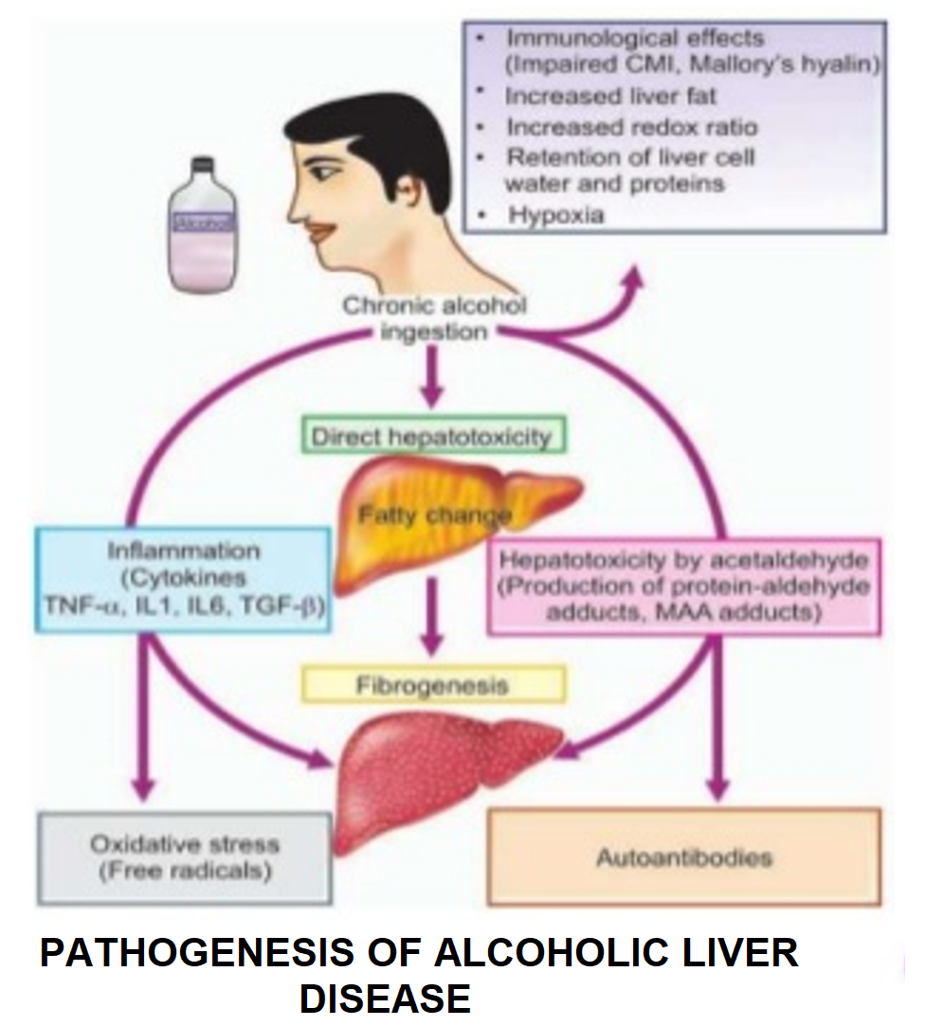
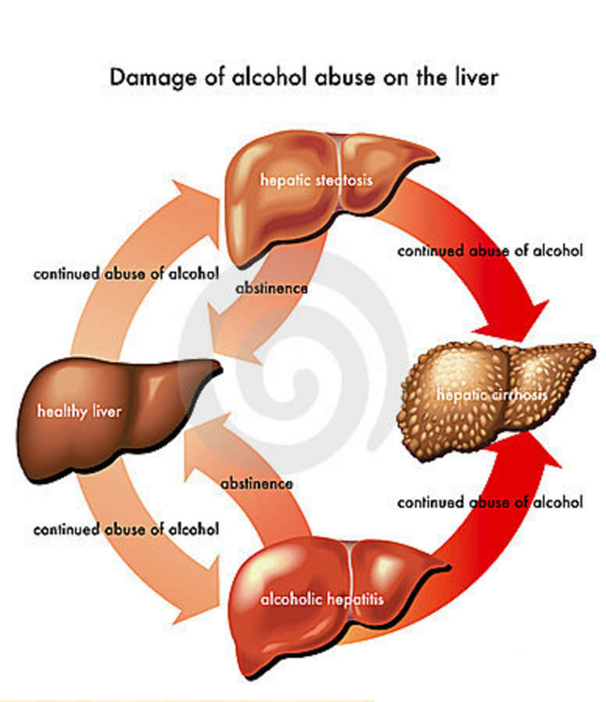
Manufactured by: M/s. Kalaga Herbal research Labs Pvt Ltd., and
Marketed by: M/s. Kalaga Integrated Health Care Pvt Ltd.
FORMULATOR OF HEPATOPROVE - DR. K.V.G.S. MURTY, MBBS

Slide 10
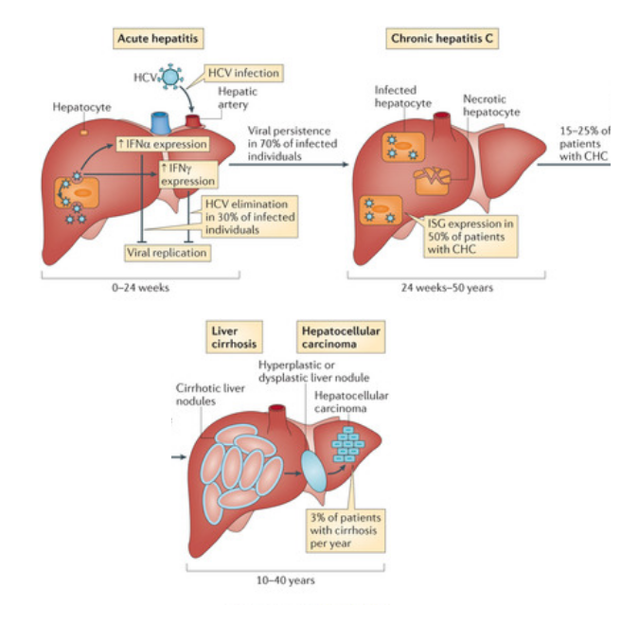
Manufactured by: M/s. Kalaga Herbal research Labs Pvt Ltd., and
Marketed by: M/s. Kalaga Integrated Health Care Pvt Ltd.
FORMULATOR OF HEPATOPROVE - DR. K.V.G.S. MURTY, MBBS

Slide 11
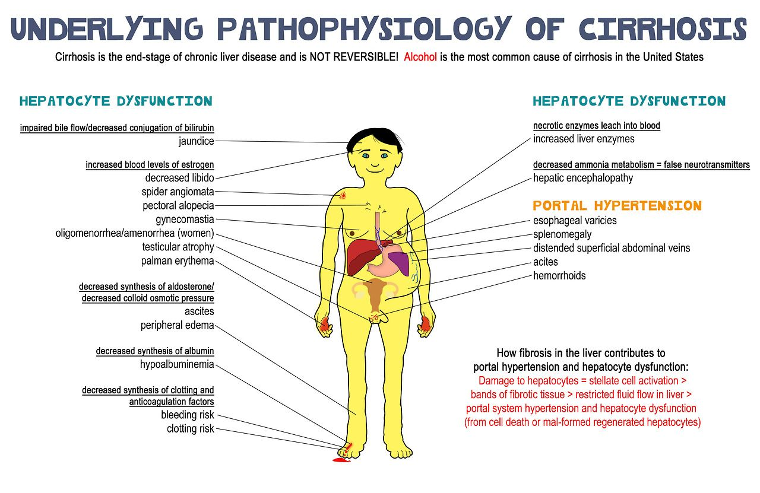
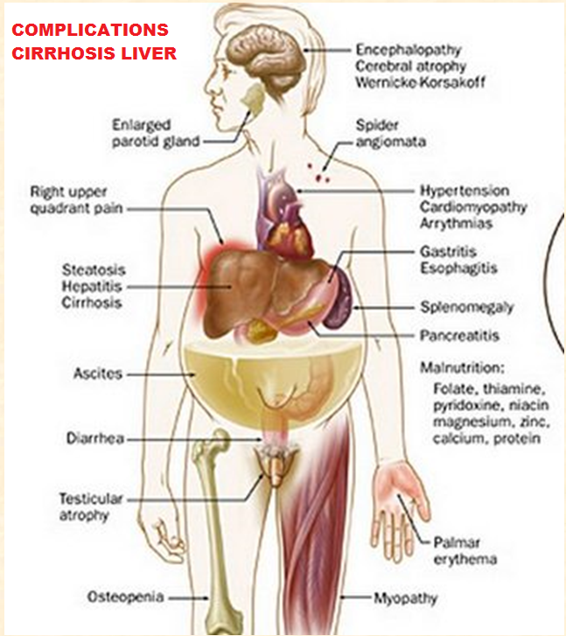
Manufactured by: M/s. Kalaga Herbal research Labs Pvt Ltd., and
Marketed by: M/s. Kalaga Integrated Health Care Pvt Ltd.
FORMULATOR OF HEPATOPROVE - DR. K.V.G.S. MURTY, MBBS

Slide 12
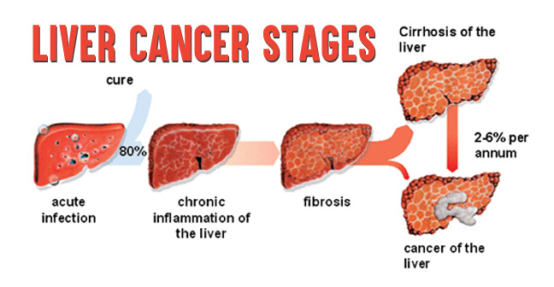
Manufactured by: M/s. Kalaga Herbal research Labs Pvt Ltd., and
Marketed by: M/s. Kalaga Integrated Health Care Pvt Ltd.
FORMULATOR OF HEPATOPROVE - DR. K.V.G.S. MURTY, MBBS

Slide 13
Manufactured by: M/s. Kalaga Herbal research Labs Pvt Ltd., and
Marketed by: M/s. Kalaga Integrated Health Care Pvt Ltd.
FORMULATOR OF HEPATOPROVE - DR. K.V.G.S. MURTY, MBBS

Slide 14
Manufactured by: M/s. Kalaga Herbal research Labs Pvt Ltd., and
Marketed by: M/s. Kalaga Integrated Health Care Pvt Ltd.
Sl. No. | Sanskrit Name Or Local Name | Botanical Name | Part used | Classical Reference
1 | Bhuamlika (Tamalaki) | Phyllanthus niruri | Whole plant | API PART – I, VOL – I, 70 PAGE NOS. 190 to 192
2 | Sveta Sariva (Ananthamool) | Hemidesmus indicus | Root | API PART – I, VOL – I, 68 PAGE NOS. 184 – 186
3 | Kalmegh | Andrographis paniculata | Whole plant | Bhavaprakasa Nighantu (India Materia Medica) of Sri Bhavamisra – Chaukhambha Bharati Academy, Varanasi Page No. 75.
4 | Guduci | Tinospora cordifolia | Whole plant | API PART – I, VOL – I, 27 PAGE NOS. 70 -72
5 | Amlavetas | Hippophae rhamnoides L | Fruit | 1.Bhavaprakasa Nighantu (India Materia Medica) of Sri Bhavamisra – Chaukhambha Bharati Academy, Varanasi Page No. 599 2.The Ayurvedic Formulary of India – Part III – Page 420, Item – 11, Department of AYUSH, Govt. Of India, Central Council for Research in Ayurveda and Sidda, Unani, Youga, Homeopathy (CCRAS), New Delhi. 2011
6 | Dugdhapheni | Taraxacum officianale | Root | 1.Bhavaprakasa Nighantu (India Materia Medica) of Sri Bhavamisra – Chaukhambha Bharati Academy, Varanasi Page No. 828
7 | Yesti Madhu | Glycyrrhiza glabra | Root | API PART – I, VOL – I, 79 PAGE NOS. 215 - 217
8 | Patola | Trichosanthes dioica | Leaf | Bhavaprakasa Nighantu (India Materia Medica) of Sri Bhavamisra – Chaukhambha Bharati Academy, Varanasi Page No. 676,686
FORMULATOR OF HEPATOPROVE - DR. K.V.G.S. MURTY, MBBS

Slide 15
Manufactured by: M/s. Kalaga Herbal research Labs Pvt Ltd., and
Marketed by: M/s. Kalaga Integrated Health Care Pvt Ltd.
FORMULATOR OF HEPATOPROVE - DR. K.V.G.S. MURTY, MBBS

