Slide 1
REDUFLAME
Manufactured by: M/s. Kalaga Herbal research Labs Pvt Ltd., and
Marketed by: M/s. Kalaga Integrated Health Care Pvt Ltd.
Can Address Sub-Clinical & Chronic Internal Inflammation related to Autoimmune, Cancer and Neurological Diseases. Brings down Inflammatory markers like High Sensitive C-Reactive Protein, Tumour Necrosis Factor (TNF), Interleukin 6 (IL 6) and Nuclear Factor Kapha Beta (NfKB).
1 or 2 CAP –Bi-Daily for a period of 90 days or as advised by Physician
FORMULATOR OF REDUFLAME - DR. K.V.G.S. MURTY, MBBS

Slide 2
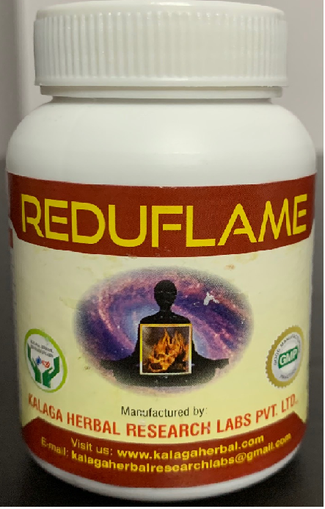
Manufactured by: M/s. Kalaga Herbal research Labs Pvt Ltd., and
Marketed by: M/s. Kalaga Integrated Health Care Pvt Ltd.
Reduflame – Capsules Benefits:
Reduces Internal Inflammation in the body parts, by correcting High Sensitive C-Reactive Protein, Tumour Necrosis Factor (TNF) and Interleukin 6 (IL 6).
Supports body cell regeneration, and improves Body Cell Resistance against Oxidative damage.
Fights internal infections with Anti-inflammatory, Anti-allergic, Anti-viral and Anti-tumour actions.
Addresses Obesity (Adapose Tissue Dysfunction).
Effective on Auto-immune diseases, Cancer and Intestinal related inflammation.
Regulates Cytokine storms.
Manufactured by: M/s. Kalaga Herbal Research Labs Pvt Ltd., 16-4-38, First Floor, Kalaga Mart, M. G. Road, Palakollu -534260, W. G. Dt., Andhra Pradesh.
technical@kalagaherbal.com, drkvgsmurty@kalagaherbal.com www.kalagaherbal.com
Marketed by: M/s. Kalaga Integrated Health Care Pvt Ltd., 2-2-1109/1, Flat No. 501, Brindavan Apartments, Bagh Amberpet, Hyderabad -50013, Telangana.
technical@kalagahealth.com, drkvgsmurty@kalagaheaalth.com www.kalagahealth.com
FORMULATOR OF REDUFLAME - DR. K.V.G.S. MURTY, MBBS

Slide 3
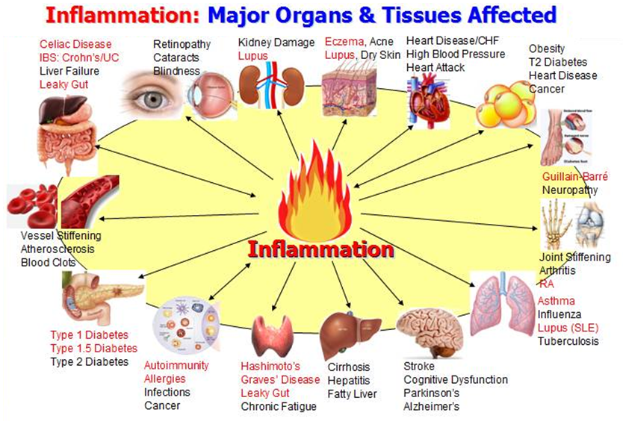
Manufactured by: M/s. Kalaga Herbal research Labs Pvt Ltd., and
Marketed by: M/s. Kalaga Integrated Health Care Pvt Ltd.
FORMULATOR OF REDUFLAME - DR. K.V.G.S. MURTY, MBBS

Slide 4
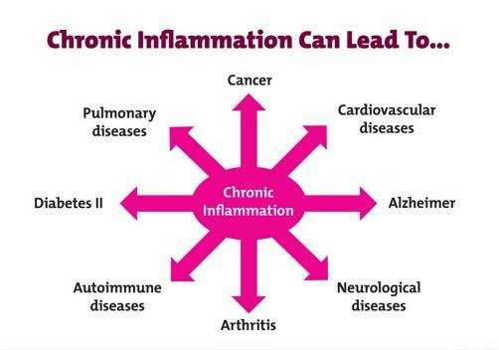
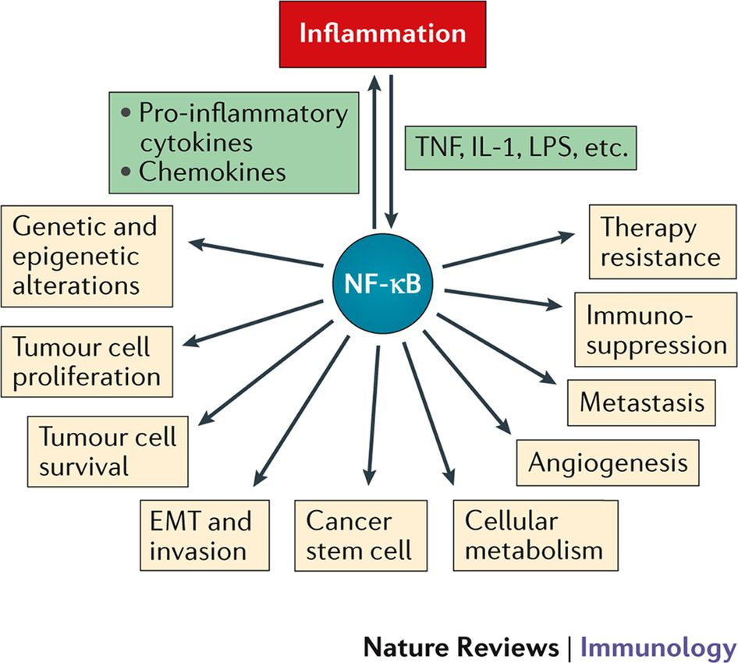
Manufactured by: M/s. Kalaga Herbal research Labs Pvt Ltd., and
Marketed by: M/s. Kalaga Integrated Health Care Pvt Ltd.
FORMULATOR OF REDUFLAME - DR. K.V.G.S. MURTY, MBBS

Slide 5
Manufactured by: M/s. Kalaga Herbal research Labs Pvt Ltd., and
Marketed by: M/s. Kalaga Integrated Health Care Pvt Ltd.
FORMULATOR OF REDUFLAME - DR. K.V.G.S. MURTY, MBBS

Slide 6
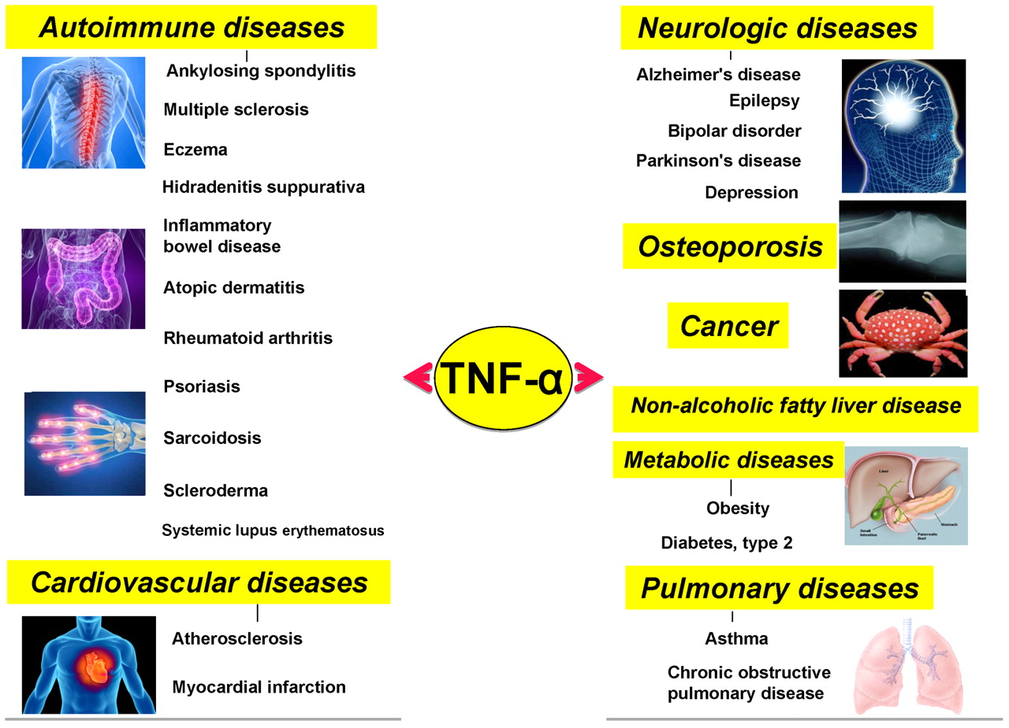
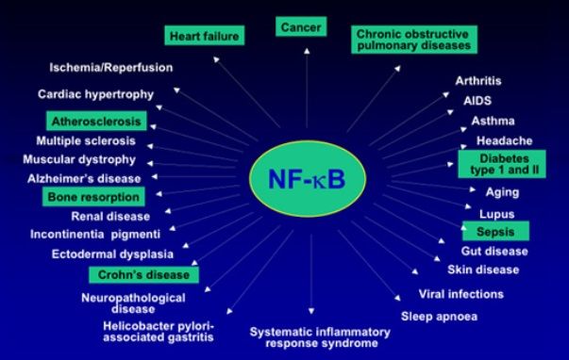
Manufactured by: M/s. Kalaga Herbal research Labs Pvt Ltd., and
Marketed by: M/s. Kalaga Integrated Health Care Pvt Ltd.
FORMULATOR OF REDUFLAME - DR. K.V.G.S. MURTY, MBBS

Slide 7
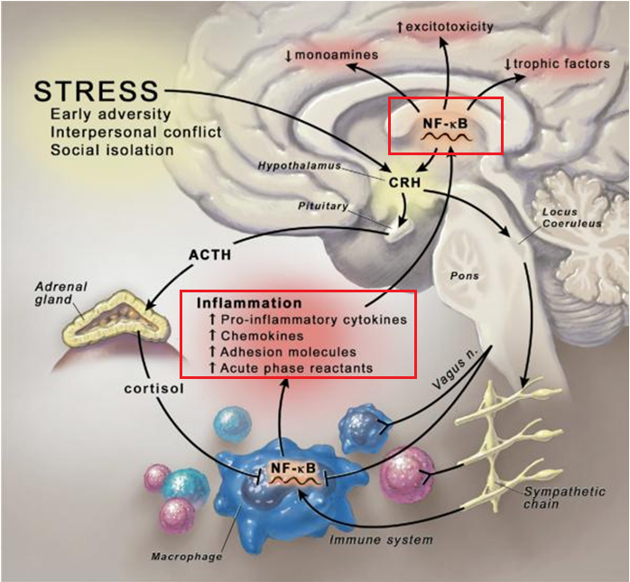
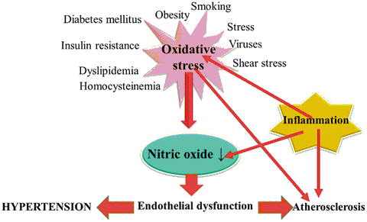
Manufactured by: M/s. Kalaga Herbal research Labs Pvt Ltd., and
Marketed by: M/s. Kalaga Integrated Health Care Pvt Ltd.
FORMULATOR OF REDUFLAME - DR. K.V.G.S. MURTY, MBBS

Slide 8
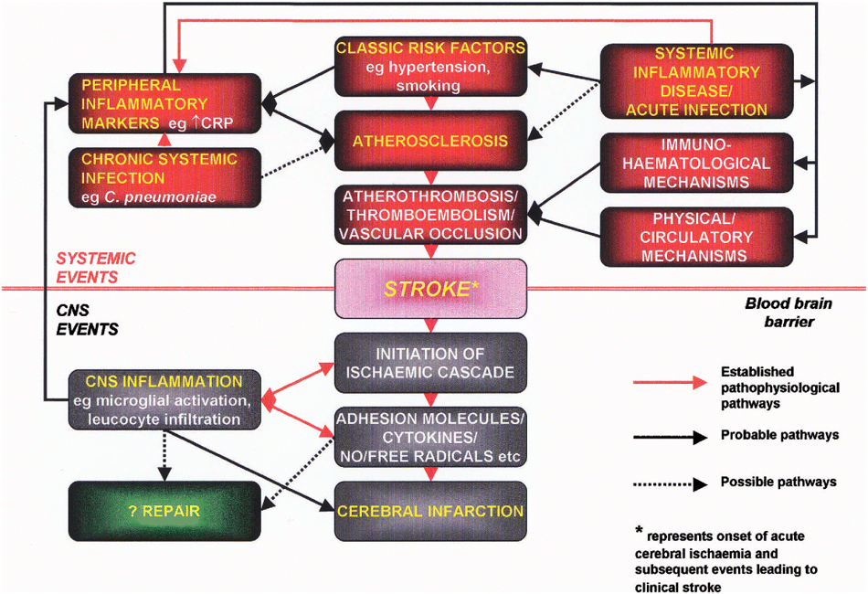
Manufactured by: M/s. Kalaga Herbal research Labs Pvt Ltd., and
Marketed by: M/s. Kalaga Integrated Health Care Pvt Ltd.
FORMULATOR OF REDUFLAME - DR. K.V.G.S. MURTY, MBBS

Slide 9
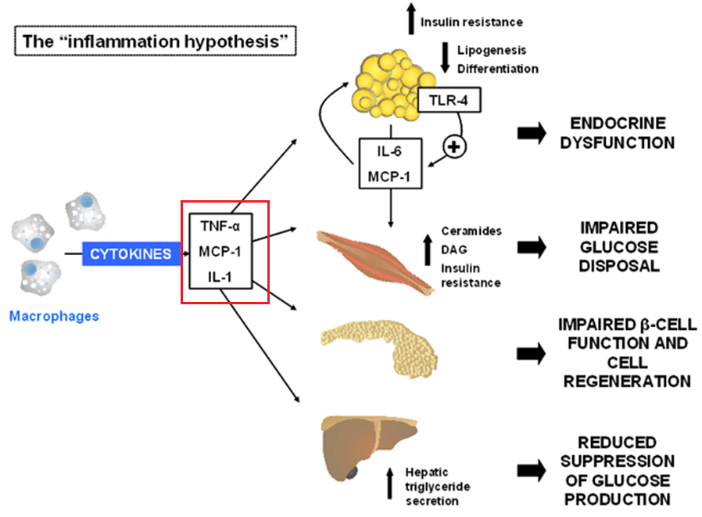
Manufactured by: M/s. Kalaga Herbal research Labs Pvt Ltd., and
Marketed by: M/s. Kalaga Integrated Health Care Pvt Ltd.
FORMULATOR OF REDUFLAME - DR. K.V.G.S. MURTY, MBBS

Slide 10
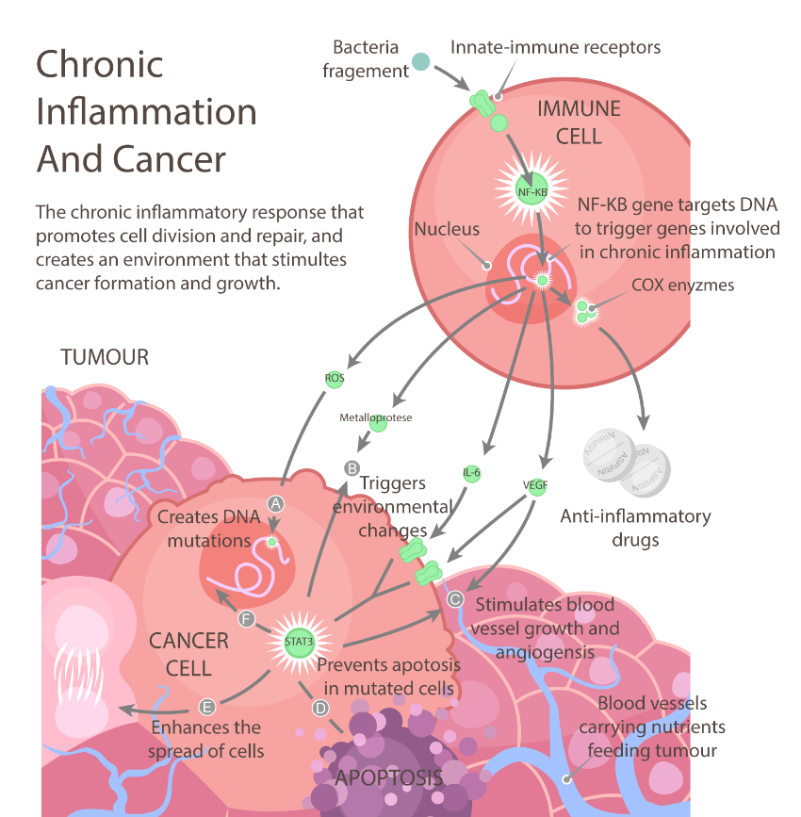
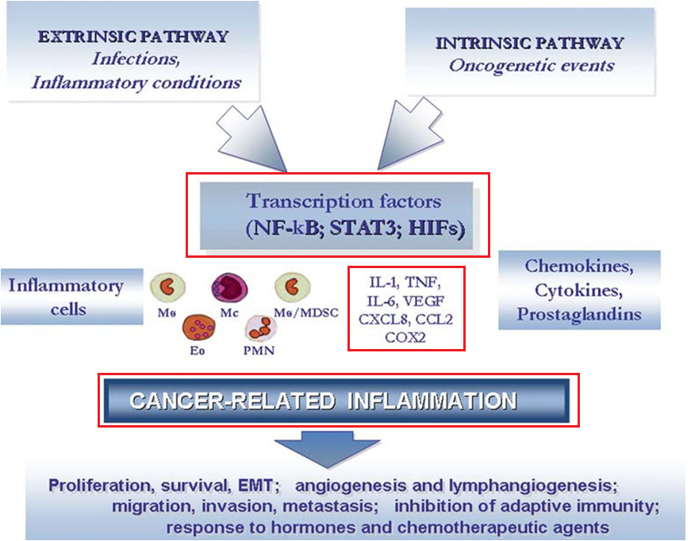
Manufactured by: M/s. Kalaga Herbal research Labs Pvt Ltd., and
Marketed by: M/s. Kalaga Integrated Health Care Pvt Ltd.
FORMULATOR OF REDUFLAME - DR. K.V.G.S. MURTY, MBBS

Slide 11
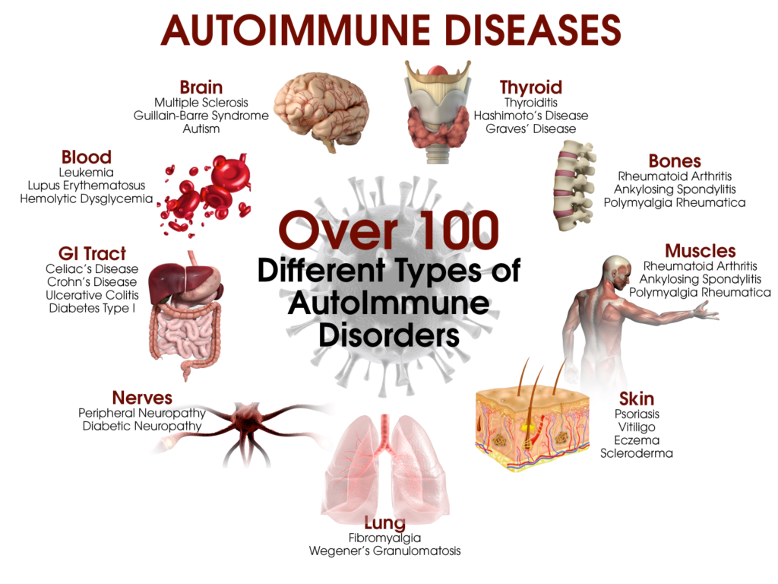
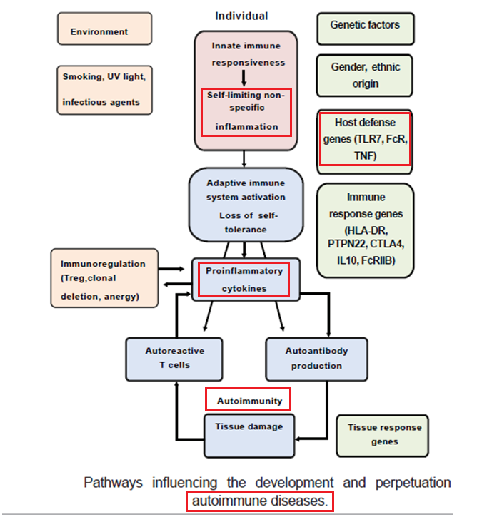
Manufactured by: M/s. Kalaga Herbal research Labs Pvt Ltd., and
Marketed by: M/s. Kalaga Integrated Health Care Pvt Ltd.
FORMULATOR OF REDUFLAME - DR. K.V.G.S. MURTY, MBBS

Slide 12
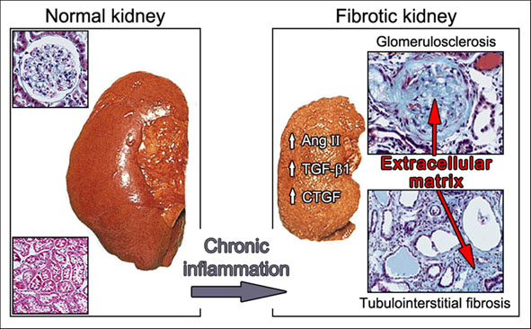
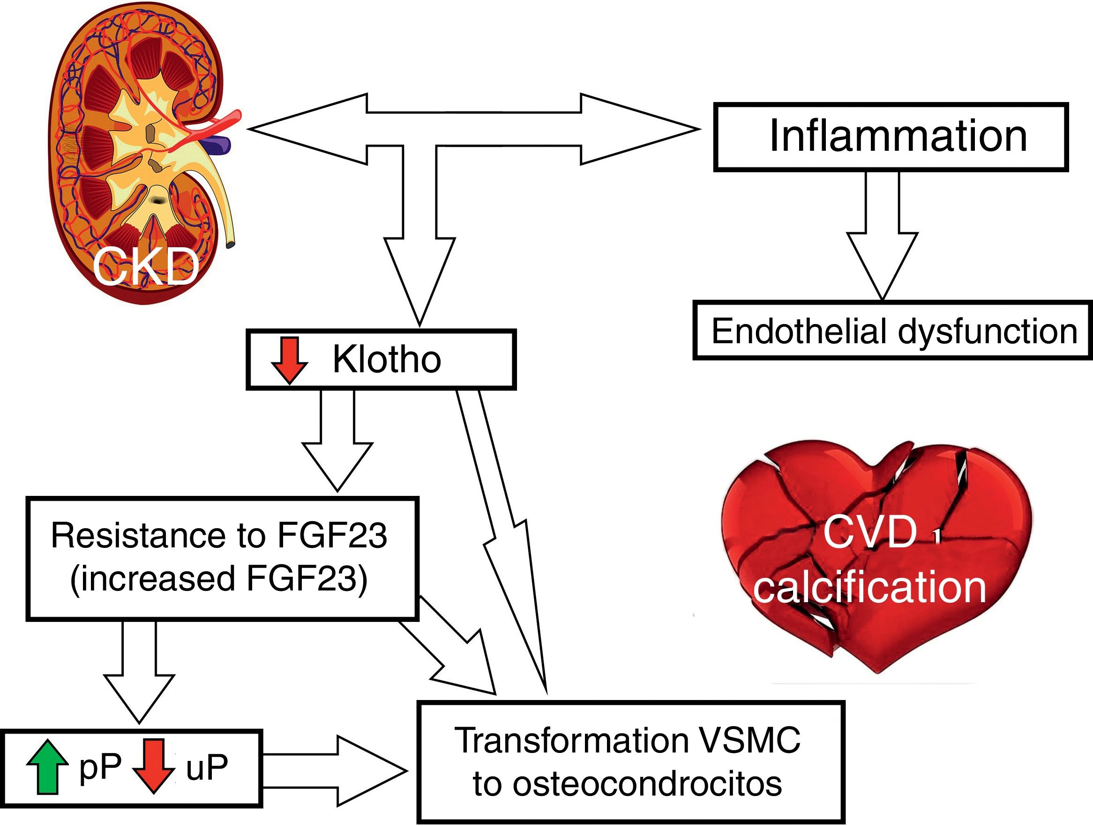
Manufactured by: M/s. Kalaga Herbal research Labs Pvt Ltd., and
Marketed by: M/s. Kalaga Integrated Health Care Pvt Ltd.
FORMULATOR OF REDUFLAME - DR. K.V.G.S. MURTY, MBBS

Slide 13
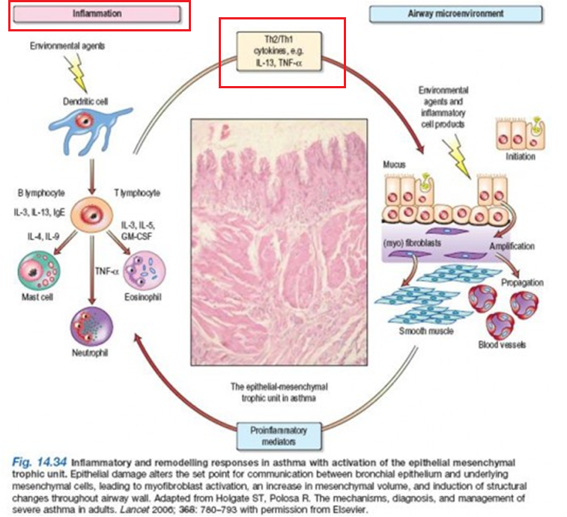
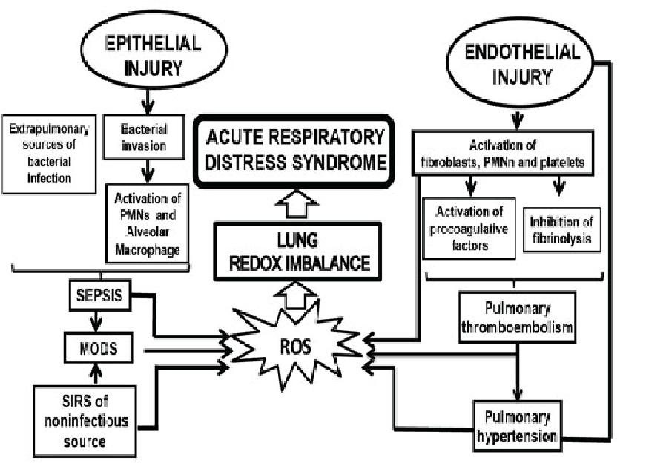
Manufactured by: M/s. Kalaga Herbal research Labs Pvt Ltd., and
Marketed by: M/s. Kalaga Integrated Health Care Pvt Ltd.
FORMULATOR OF REDUFLAME - DR. K.V.G.S. MURTY, MBBS

Slide 14
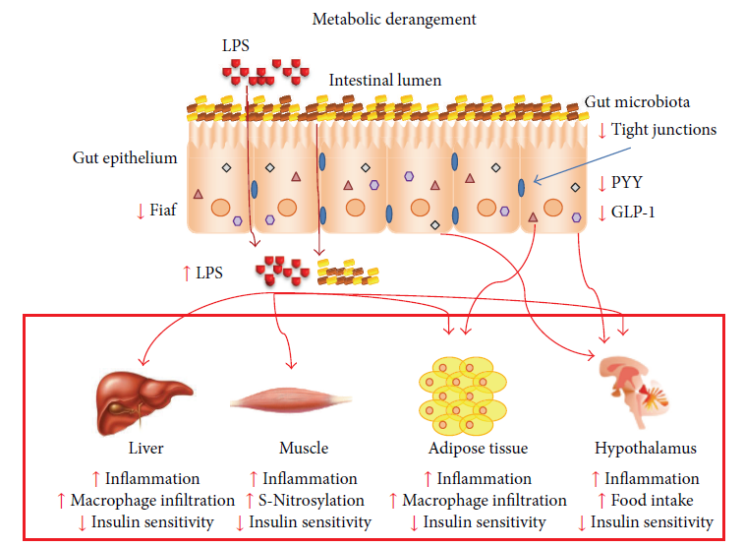
Manufactured by: M/s. Kalaga Herbal research Labs Pvt Ltd., and
Marketed by: M/s. Kalaga Integrated Health Care Pvt Ltd.
FORMULATOR OF REDUFLAME - DR. K.V.G.S. MURTY, MBBS

Slide 15
Manufactured by: M/s. Kalaga Herbal research Labs Pvt Ltd., and
Marketed by: M/s. Kalaga Integrated Health Care Pvt Ltd.
Sl. No. | Sanskrit Name Or Local Name | Botanical Name | Part used | Classical Reference
1 | Asoca | Saraca asoca | Bark | API PART – I, VOL – I, 9 PAGE NOS. 24-25
2 | Amlaki | Emblica officinalis Gaertn. | Fruit | API PART – I, VOL – I, 3 PAGE NOS. 06-08
3 | Lashuna | Allium sativam Linn. | Bulb | API PART – I, VOL – III, 50 PAGE NOS. 163 to 165
4 | Haridra | Cucuma longa | Rizome | API PART – I, VOL – I, 30 PAGE NOS. 77-79
5 | Kunduru | Boswella serrata | Gum Resin | API PART – I, VOL – IV, 24 – PAGE NOS. 83 – 85
6 | Guggulu | Commiphora mukul | Gum Resin | API PART – I, VOL – I, 28 PAGE NOS. 73 - 74
7 | Punarnava | Borehaavia diffusa | Whole Plant | API PART – I, VOL – I, 60 PAGE NOS. 163 - 165
8 | Chitrak | Plumbago Indica | Root | API PART – I, VOL – I, 20 PAGE NOS. 52 - 54
FORMULATOR OF REDUFLAME - DR. K.V.G.S. MURTY, MBBS

